Slide 1
CONNECT 4
WITH
ARTIFICIAL INTELLIGENCE
By :
PRABHJOT SINGH
NITIN RAIZADA
PUNEET ARORA
GURPREET SINGH
PULKIT SINGH

Slide 2
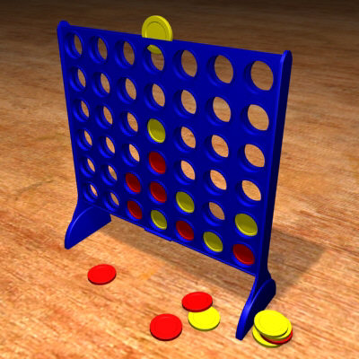
WHAT IS CONNECT4 ?
Connect Four (also known as Four Up, Plot Four, Find Four, Four in a Row, and Four in a Line) is a two-player game in which the players first choose a color and then take turns dropping their colored discs from the top into a seven-column, six-row vertically-suspended grid.
The board has 42 spaces: 7 columns (vertical lines) and 6 rows (horizontal lines). When all 42 spaces are empty, it is the first player's (Red) turn to move.
The pieces fall straight down, occupying the next available space within the column.

Slide 3
IMPLEMENTATION OF CONNECT4
Connect4 with Artificial Intelligence:
CPU plays against a human opponent. CPU will try to force a win by using predefined algorithms.
Multiplayer Connect4:
A human opponent plays against another human opponent sitting at a remote site. The game is synchronized with the help of messages that are transferred over Internet.

Slide 4
DESIGN CONSTRAINTS
ARTIFICIAL INTELLIGENCE:
In this implementation the only constraint is Time.
MULTIPLAYER:
In this implementation the processing depends upon the messages that are received from the other player, hence it should be ensured that the code is always ready to accept the messages.

Slide 5
THE GAME LOOP
A single, infinite loop is executed to obtain continual responses of the players.
Game Loop is responsible for execution of different ‘Actions’ during the whole period of play.
Every iteration of game loop produces a different output frame.

Slide 6
ALGORITHM USED
If CPU sees an opportunity to make it 4 in a row, it will take that opportunity.
If the above case is not feasible then CPU will try to block the cell where the opponent can drop the fourth chip and force a win.
In the absence of any cells that constitute the above case, CPU will search for any two chips in a row and try to make a three in a row.
If all the above cases are not possible then the CPU will use a PRIORITY MATRIX to select the column number.

Slide 7
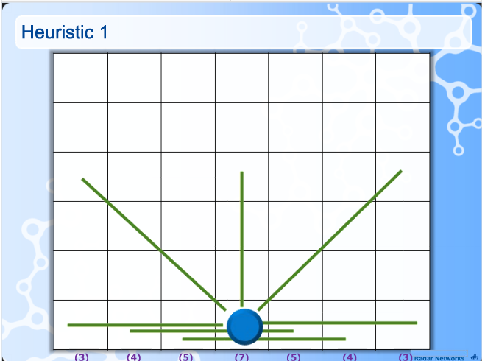
PRIORITY MATRIX

Slide 8
PRIORITY MATRIX contd..
If the CPU is not able to search for any cell through which it can enforce a win, it will take the help of priority matrix.
The value of each cell of priority matrix is calculated at the start of the program.
CPU will drop the chip in the cell with the highest priority thereby increasing it’s chances of winning.

Slide 9
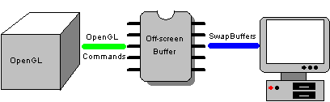
DOUBLE BUFFERING
USING A TEMPORARY BACKBUFFER

Slide 10
DOUBLE BUFFERING contd..
For displaying Graphics the concept of Double Buffering is used.
Every frame displayed on the screen is first generated on a temporary Back Buffer.
After the end of each iteration of the game loop the back buffer is displayed on the screen.
Double Buffering reduces flickering.

Slide 11
THE LAYERED APPROACH
The main challenge of multiplayer gaming is to keep the thread idle for receiving network messages.
In multiplayer gaming the game designing and computation is done in very short impulses of CPU that are obtained by thrifty usage of thread running time.
Returning a Boolean variable at the end of execution of the process indicates the completion of an ‘Action’.

Slide 12
VISUAL EFFECTS
Chips dropping with acceleration
3-d transparent board that gives the illusion that the chip is falling through a solid board
Hovering effect
Bouncing effect
Blinking of the chips when four in a row are connected
Player Avatars

Slide 13
What Are ‘Actions’
Actions are special classes in JAVA that include three basic functions
“Process”-Programming is done in this function
“Draw”- In this function frame is drawn according to action
“Message In”-Checks and decodes the incoming messages.

Slide 14
‘Actions’ Used in The Game
Action Ready
Action Player Making Move
Action Waiting for Turn
Action Drop Chip
Action Game Over
Action Play Again

Slide 15
Data Structures Used
2-D Array
A 6X7 Matrix storing the board status
BoardStatus[i][j] represents state of cell at ith row and jth column.
9->Empty
0->Player 1(Blue)
1->Player 2(Orange)
BoardX and BoardY storing X and Y coordinates of the cells of board
When a winner is detected BoardStatus changes to
100->Blue
101->Orange

Slide 16
Data Structures Used
2-D Array contd..
A 6X7 matrix named as fake board status
It is used in the Artificial Intelligence implementation of Connect4. CPU before making a move updates the fake board status. The algorithms for AI uses the values of fake board status to select the best possible move. Fake board status is synchronized with the current board status after each iteration of the loop.

Slide 17
Data Structures Used
Arraylist
Arraylist used for storing ‘Actions’ .
Arraylist used for storing messages.
Arraylist used for adding players.

Slide 18

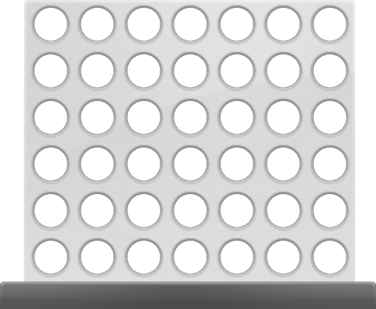



Slide 19
THANK YOU

